Slide 1
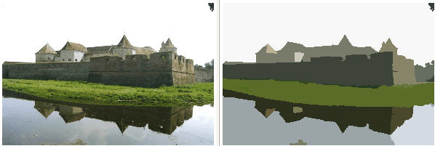
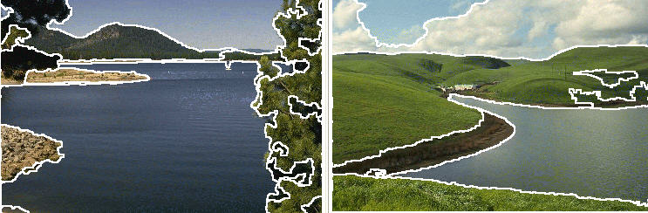
Lecture 11
Segmentation and Grouping
Gary Bradski
Sebastian Thrun
*
http://robots.stanford.edu/cs223b/index.html
* Pictures from Mean Shift: A Robust Approach toward Feature Space Analysis, by D. Comaniciu and P. Meer http://www.caip.rutgers.edu/~comanici/MSPAMI/msPamiResults.html

Slide 2
Outline
Segmentation Intro
  What and why
  Biological
Segmentation:
By learning the background
By energy minimization
  Normalized Cuts
By clustering
  Mean Shift (perhaps the best technique to date)
By fitting
  optional, but projects doing SFM should read.
Reading source: Forsyth Chapters in segmentation, available (at least this term)
http://www.cs.berkeley.edu/~daf/new-seg.pdf

Slide 3
Intro: Segmentation and Grouping
What: Segmentation breaks an image into groups over space and/or time
Why:
Motivation:
  not for recognition
  for compression
Relationship of sequence/set of tokens
  Always for a goal or application
Currently, no real theory
Tokens are
  The things that are grouped (pixels, points, surface elements, etc., etc.)
top down segmentation
  tokens grouped because they lie on the same object
bottom up segmentation
  tokens belong together because of some local affinity measure
Bottom up/Top Dowon need not be mutually exclusive

Slide 4
Biological:
Segmentation in Humans

Slide 5
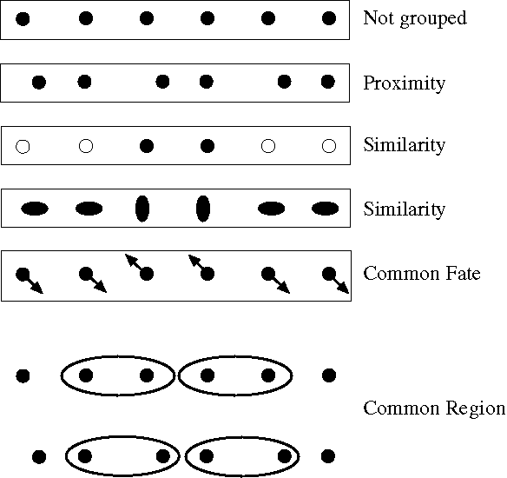
Biological:
For humans at least, Gestalt psychology identifies several properties that result
In grouping/segmentation:
Notes:
Some criteria that tend to cause tokens to be grouped.

Slide 6
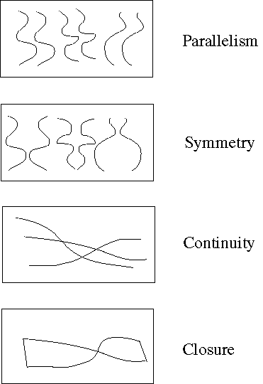
Biological:
For humans at least, Gestalt psychology identifies several properties that result
In grouping/segmentation:
Notes:
More such

Slide 7
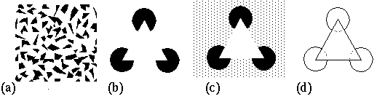
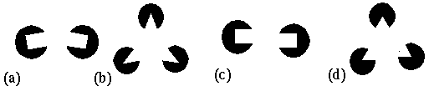
Consequence:
Groupings by Invisible Completions
Stressing the invisible groupings:
* Images from Steve Lehar’s Gestalt papers: http://cns-alumni.bu.edu/pub/slehar/Lehar.html

Slide 8
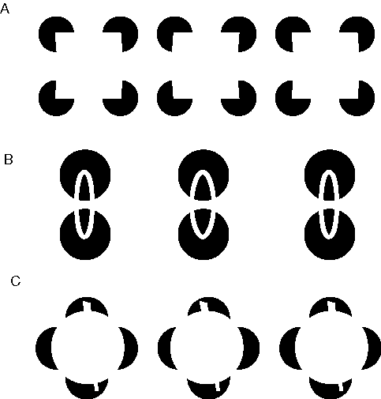
Consequence:
Groupings by Invisible Completions
* Images from Steve Lehar’s Gestalt papers: http://cns-alumni.bu.edu/pub/slehar/Lehar.html

Slide 9
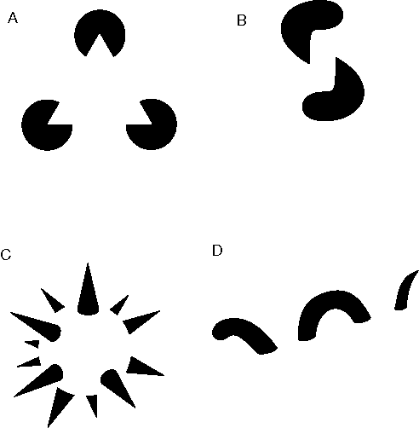
Consequence:
Groupings by Invisible Completions
* Images from Steve Lehar’s Gestalt papers: http://cns-alumni.bu.edu/pub/slehar/Lehar.html

Slide 10
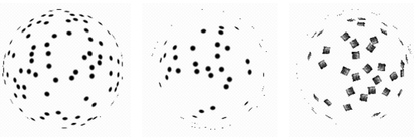
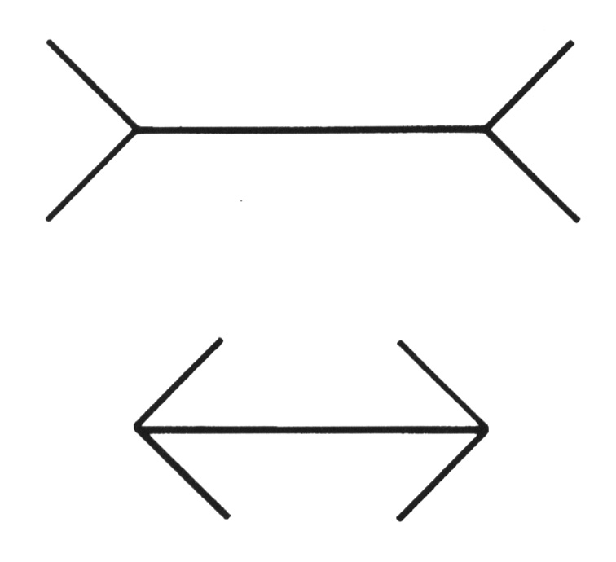
Here, the 3D nature of grouping is apparent:
Why do these tokens belong together?
Corners and creases in 3D, length is interpreted differently:
In
The (in) line at the far
end of corridor must
be longer than the (out)
near line if they measure
to be the same size
Out
Notes:
A disturbing possibility is that they all lie on a sphere -- but then, if we didn’t know that the tokens belonged together,
where did the sphere come from?

Slide 11
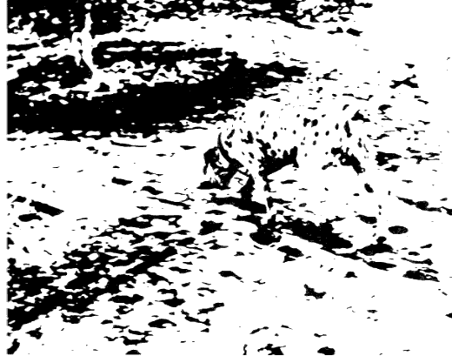
And the famous invisible dog eating under a tree:

Slide 12
Background Subtraction

Slide 13
Background Subtraction
Learn model of the background
  By statistics (μ,σ); mixture of Gaussians; Adaptive filter, etc
Take absolute difference with current frame
  Pixels greater than a threshold are candidate foreground
Use morphological open operation to clean up point noise.
Traverse the image and use flood fill to measure size of candidate regions.
  Assign as foreground those regions bigger than a set value.
  Zero out regions that are too small.
Track 3 temporal modes:
  (1) Quick regional changes are foreground (people, moving cars);
  (2) Changes that stopped a medium time ago are candidate background (chairs that got moved etc);
  (3) Long term statistically stable regions are background.

Slide 14
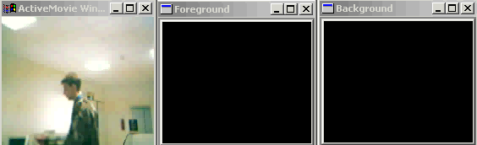
Background Subtraction Example
Notes:
Reconsider this slide!

Slide 15





Background Subtraction Principles
At ICCV 1999, MS Research presented a study, Wallflower: Principles and Practice of Background Maintenance, by Kentaro Toyama, John Krumm, Barry Brumitt, Brian Meyers. This paper compared many different background subtraction techniques and came up with some principles:
P1:
P2:
P3:
P4:
P5:

Slide 16
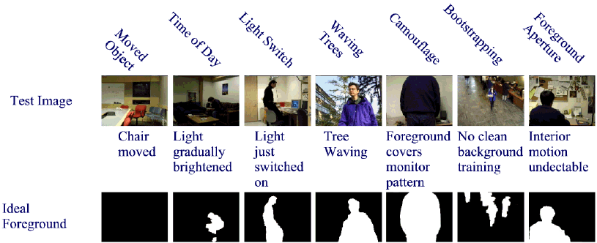
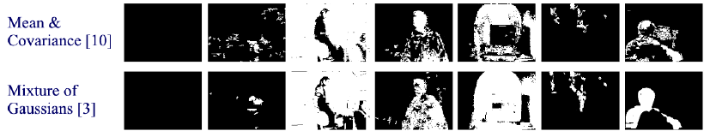
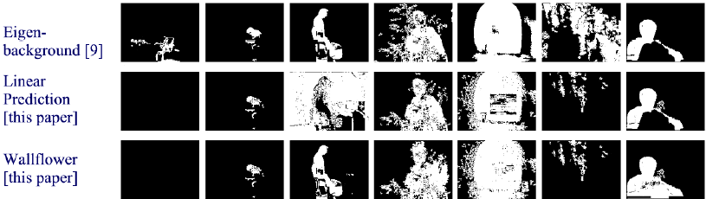
Background Techniques Compared
From the Wallflower Paper

Slide 17
Segmentation by Energy Minimization:
Graph Cuts

Slide 18
Graph theoretic clustering
Represent tokens (which are associated with each pixel) using a weighted graph.
  affinity matrix (p_{i} same as p_{j} => affinity of 1)
Cut up this graph to get subgraphs with strong interior links and weaker exterior links
Application to vision originated with Prof. Malik at Berkeley

Slide 19
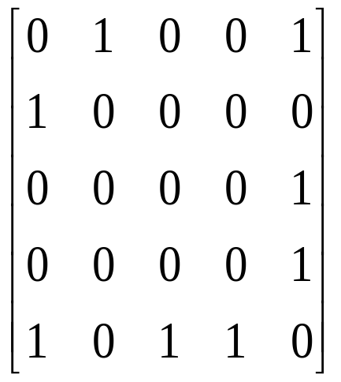
Graphs Representations
a
b
c
e
d
Adjacency Matrix: W
* From Khurram Hassan-Shafique CAP5415 Computer Vision 2003

Slide 20
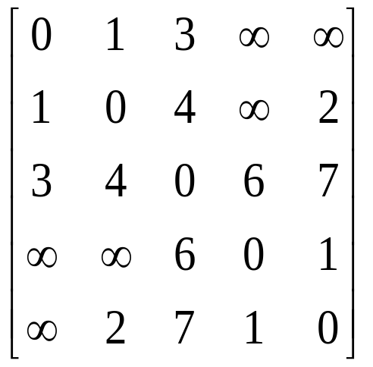
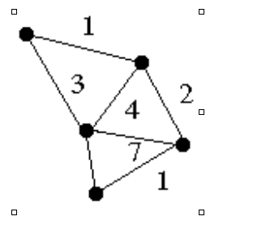
Weighted Graphs and Their Representations
a
b
c
e
6
d
Weight Matrix: W
* From Khurram Hassan-Shafique CAP5415 Computer Vision 2003

Slide 21
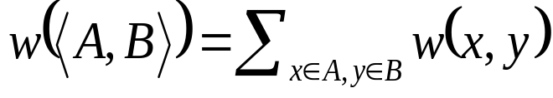
Minimum Cut
A cut of a graph G is the set of
edges S such that removal of
S from G disconnects G.
Minimum cut is the cut of minimum weight, where weight of cut <A,B> is given as
* From Khurram Hassan-Shafique CAP5415 Computer Vision 2003

Slide 22

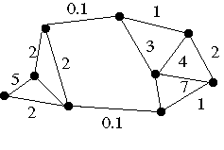
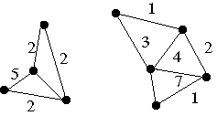
Minimum Cut and Clustering
* From Khurram Hassan-Shafique CAP5415 Computer Vision 2003

Slide 23
Image Segmentation & Minimum Cut
Pixel
Neighborhood
Image
Pixels
w
Similarity
Measure
Minimum
Cut
* From Khurram Hassan-Shafique CAP5415 Computer Vision 2003

Slide 24
Minimum Cut
There can be more than one minimum cut in a given graph
All minimum cuts of a graph can be found in polynomial time¹.
¹H. Nagamochi, K. Nishimura and T. Ibaraki, “Computing all small cuts in an undirected network. SIAM J. Discrete Math. 10 (1997) 469-481.
* From Khurram Hassan-Shafique CAP5415 Computer Vision 2003

Slide 25
Finding the Minimal Cuts:
Spectral Clustering Overview
Data
Similarities
Block-Detection
* Slides from Dan Klein, Sep Kamvar, Chris Manning, Natural Language Group Stanford University

Slide 26
Eigenvectors and Blocks
Block matrices have block eigenvectors:
Near-block matrices have near-block eigenvectors: [Ng et al., NIPS 02]
λ₁= 2
λ₂= 2
λ₃= 0
λ₄= 0
1 | 1 | 0 | 0
1 | 1 | 0 | 0
0 | 0 | 1 | 1
0 | 0 | 1 | 1
.71
.71
0
0
0
0
.71
.71
eigensolver
λ₁= 2.02
λ₂= 2.02
λ₃= -0.02
λ₄= -0.02
1 | 1 | .2 | 0
1 | 1 | 0 | -.2
.2 | 0 | 1 | 1
0 | -.2 | 1 | 1
.71
.69
.14
0
0
-.14
.69
.71
eigensolver
* Slides from Dan Klein, Sep Kamvar, Chris Manning, Natural Language Group Stanford University

Slide 27
Spectral Space
Can put items into blocks by eigenvectors:
Clusters clear regardless of row ordering:
e₁
1 | 1 | .2 | 0
1 | 1 | 0 | -.2
.2 | 0 | 1 | 1
0 | -.2 | 1 | 1
.71
.69
.14
0
0
-.14
.69
.71
e₂
e₁
e₂
e₁
1 | .2 | 1 | 0
.2 | 1 | 0 | 1
1 | 0 | 1 | -.2
0 | 1 | -.2 | 1
.71
.14
.69
0
0
.69
-.14
.71
e₂
e₁
e₂
* Slides from Dan Klein, Sep Kamvar, Chris Manning, Natural Language Group Stanford University

Slide 28
The Spectral Advantage
The key advantage of spectral clustering is the spectral space representation:
* Slides from Dan Klein, Sep Kamvar, Chris Manning, Natural Language Group Stanford University

Slide 29
Clustering and Classification
Once our data is in spectral space:
  Clustering
  Classification
* Slides from Dan Klein, Sep Kamvar, Chris Manning, Natural Language Group Stanford University

Slide 30
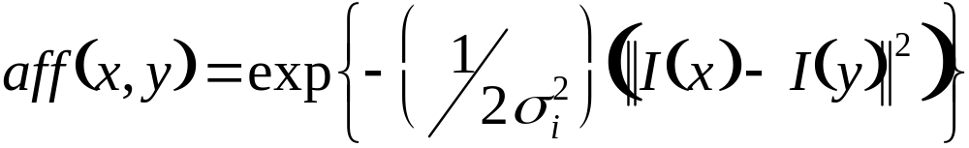
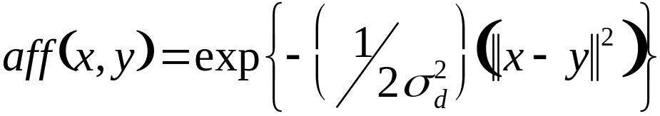
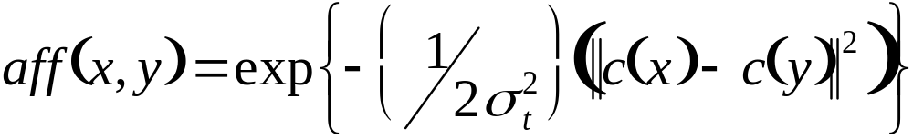
Measuring Affinity
Intensity
Distance
Texture
* From Marc Pollefeys COMP 256 2003
Notes:
here c(x) is a vector of filter outputs. A natural thing to do is to square the outputs of a range of different filters at different scales and orientations, smooth the result, and rack these into a vector.

Slide 31
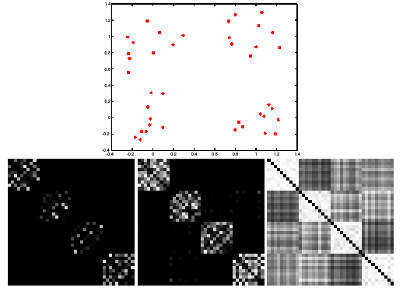

Scale affects affinity
* From Marc Pollefeys COMP 256 2003
Notes:
This is figure 14.18

Slide 32
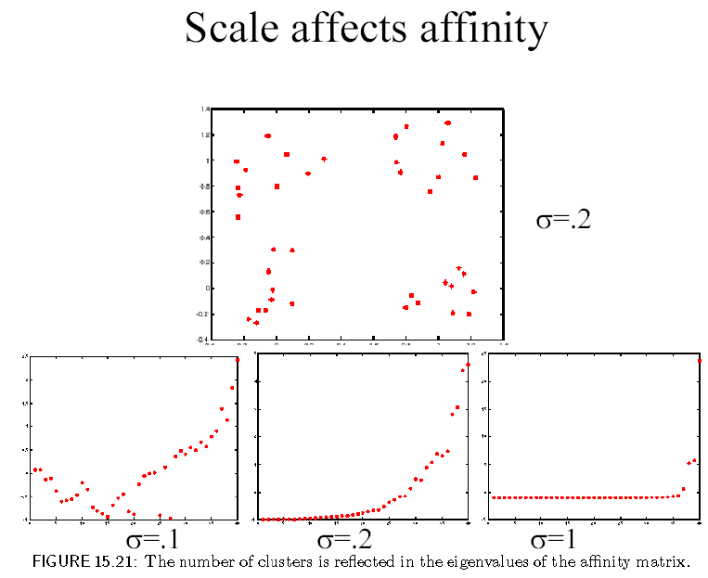
* From Marc Pollefeys COMP 256 2003

Slide 33
Drawbacks of Minimum Cut
Weight of cut is directly proportional to the number of edges in the cut.
Cuts with
lesser weight
than the
ideal cut
Ideal Cut
* Slide from Khurram Hassan-Shafique CAP5415 Computer Vision 2003

Slide 34
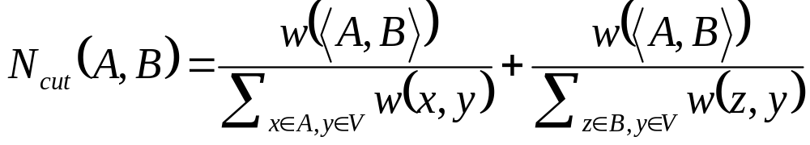
Normalized Cuts¹
Normalized cut is defined as
N_{cut}(A,B) is the measure of dissimilarity of sets A and B.
Minimizing N_{cut}(A,B) maximizes a measure of similarity within the sets A and B
¹J. Shi and J. Malik, “Normalized Cuts & Image Segmentation,” IEEE Trans. of PAMI, Aug 2000.
* Slide from Khurram Hassan-Shafique CAP5415 Computer Vision 2003

Slide 35
Finding Minimum Normalized-Cut
Finding the Minimum Normalized-Cut is NP-Hard.
Polynomial Approximations are generally used for segmentation
* Slide from Khurram Hassan-Shafique CAP5415 Computer Vision 2003

Slide 36
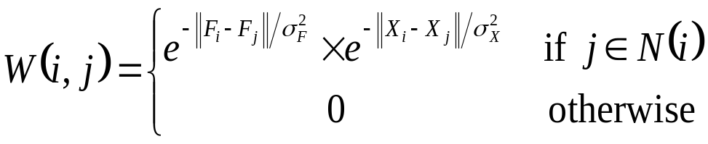
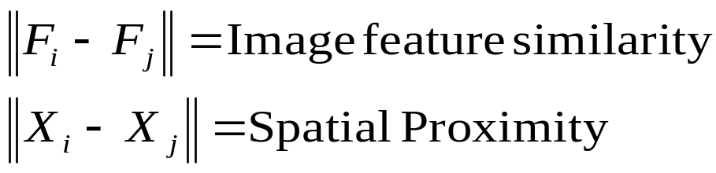
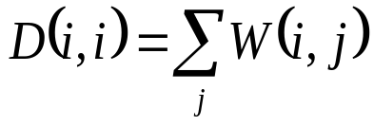
Finding Minimum Normalized-Cut
* From Khurram Hassan-Shafique CAP5415 Computer Vision 2003

Slide 37
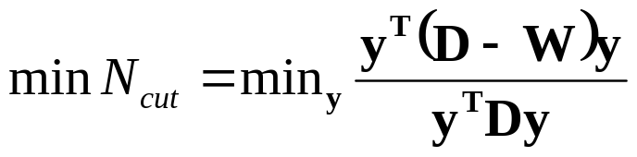

Finding Minimum Normalized-Cut
It can be shown that
such that
If y is allowed to take real values then the minimization can be done by solving the generalized eigenvalue system
* Slide from Khurram Hassan-Shafique CAP5415 Computer Vision 2003

Slide 38
Algorithm
Compute matrices W & D
Solve for eigen vectors with the smallest eigen values
Use the eigen vector with second smallest eigen value to bipartition the graph
Recursively partition the segmented parts if necessary.
* Slide from Khurram Hassan-Shafique CAP5415 Computer Vision 2003

Slide 39
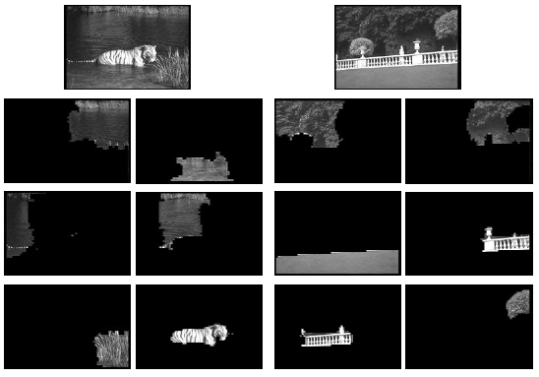
Figure from “Image and video segmentation: the normalised cut framework”,
by Shi and Malik, 1998
* Slide from Khurram Hassan-Shafique CAP5415 Computer Vision 2003
Notes:
This is figure 14.23 - caption there explains it all.

Slide 40
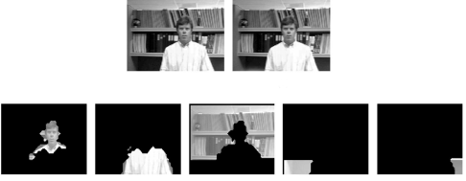
F igure from “Normalized cuts and image segmentation,” Shi and Malik, 2000
* Slide from Khurram Hassan-Shafique CAP5415 Computer Vision 2003
Notes:
This is figure 14.24, whose caption gives the story

Slide 41
Drawbacks of Minimum Normalized Cut
Huge Storage Requirement and time complexity
Bias towards partitioning into equal segments
Have problems with textured backgrounds
* Slide from Khurram Hassan-Shafique CAP5415 Computer Vision 2003

Slide 42
Segmentation by Clustering

Slide 43
Segmentation as clustering
Cluster together (pixels, tokens, etc.) that belong together
Agglomerative clustering
  attach closest to cluster it is closest to
  repeat
Divisive clustering
  split cluster along best boundary
  repeat
Point-Cluster distance
  single-link clustering
  complete-link clustering
  group-average clustering
Dendrograms
  yield a picture of output as clustering process continues
* From Marc Pollefeys COMP 256 2003

Slide 44
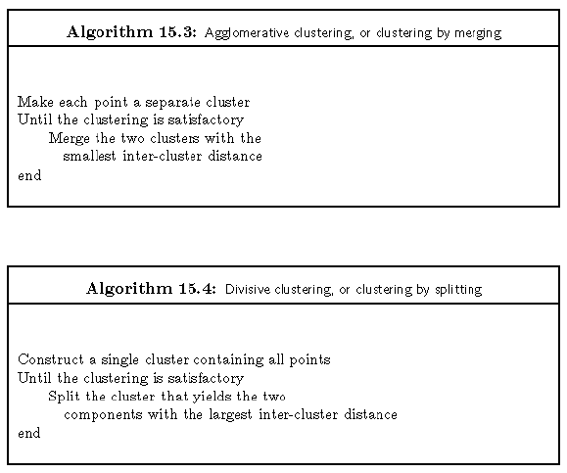
Simple clustering algorithms
* From Marc Pollefeys COMP 256 2003

Slide 45
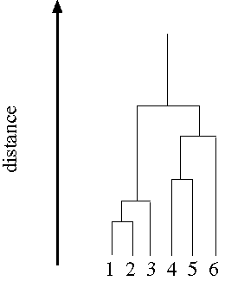
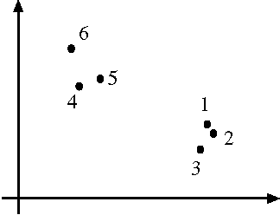
* From Marc Pollefeys COMP 256 2003

Slide 46
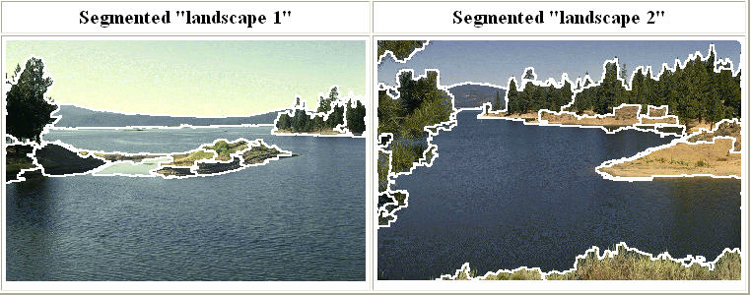
Mean Shift Segmentation
Perhaps the best technique to date…
http://www.caip.rutgers.edu/~comanici/MSPAMI/msPamiResults.html

Slide 47
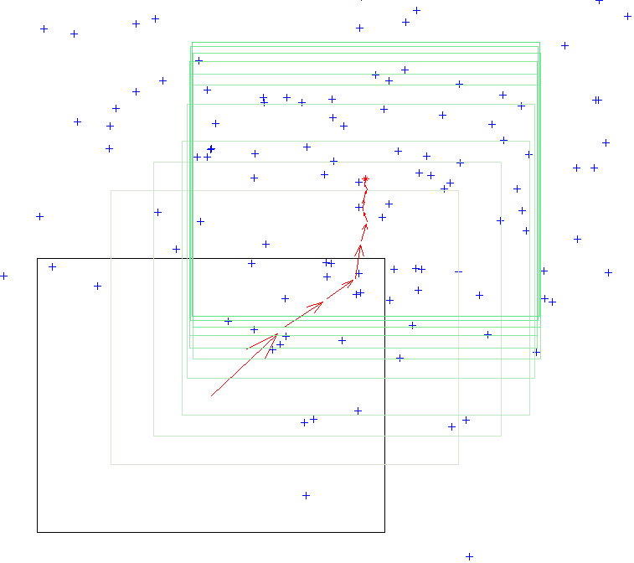
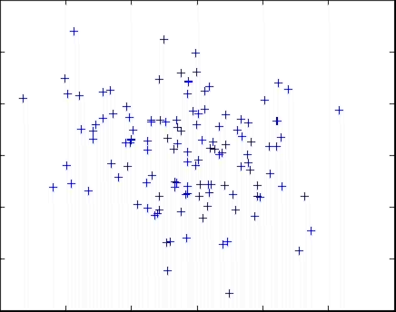
Mean Shift Algorithm
Mean Shift Algorithm
  Choose a search window size.
  Choose the initial location of the search window.
  Compute the mean location (centroid of the data) in the search window.
  Center the search window at the mean location computed in Step 3.
  Repeat Steps 3 and 4 until convergence.
The mean shift algorithm seeks the “mode” or point of highest density of a data distribution:

Slide 48
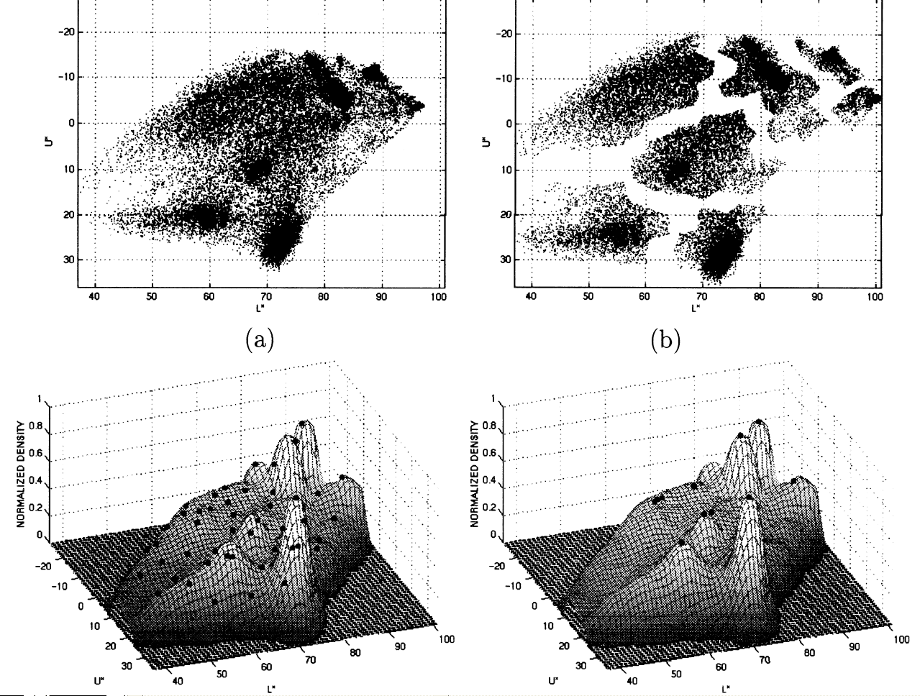
Mean Shift Segmentation
Mean Shift Setmentation Algorithm
  Convert the image into tokens (via color, gradients, texture measures etc).
  Choose initial search window locations uniformly in the data.
  Compute the mean shift window location for each initial position.
  Merge windows that end up on the same “peak” or mode.
  The data these merged windows traversed are clustered together.
*Image From: Dorin Comaniciu and Peter Meer, Distribution Free Decomposition of Multivariate Data, Pattern Analysis & Applications (1999)2:22–30

Slide 49
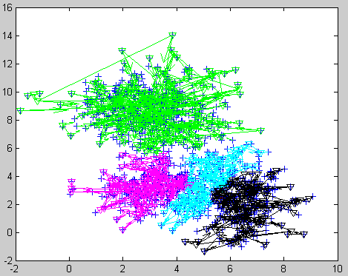
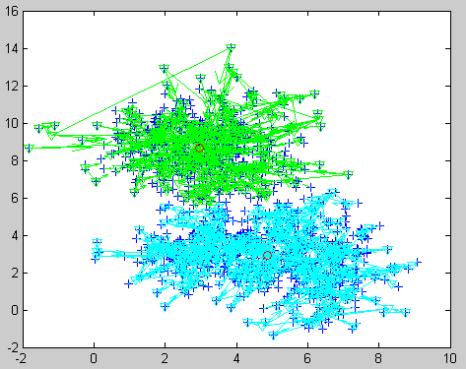
Mean Shift Segmentation Extension
Is scale (search window size) sensitive. Solution, use all scales:
Gary Bradski’s internally published agglomerative clustering extension:
Mean shift dendrograms
Place a tiny mean shift window over each data point
Grow the window and mean shift it
Track windows that merge along with the data they transversed
Until everything is merged into one cluster
Best 4 clusters:
Best 2 clusters:
Advantage over agglomerative clustering: Highly parallelizable

Slide 50
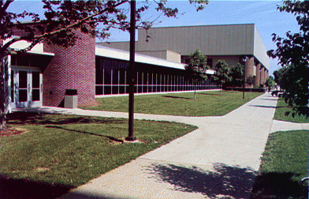
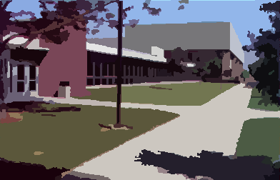
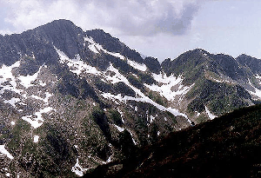
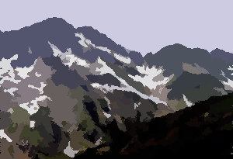
Mean Shift Segmentation
Results:
http://www.caip.rutgers.edu/~comanici/MSPAMI/msPamiResults.html

Slide 51
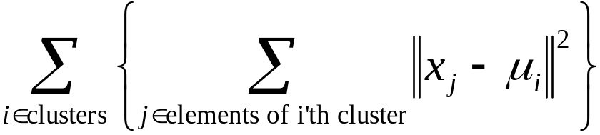
K-Means
Choose a fixed number of clusters
Choose cluster centers and point-cluster allocations to minimize error
can’t do this by search, because there are too many possible allocations.
Algorithm
  fix cluster centers; allocate points to closest cluster
  fix allocation; compute best cluster centers
x could be any set of features for which we can compute a distance (careful about scaling)
* From Marc Pollefeys COMP 256 2003

Slide 52
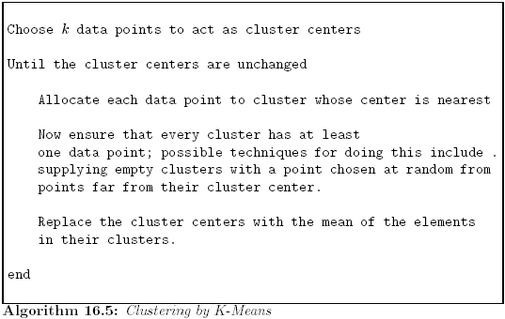
K-Means
* From Marc Pollefeys COMP 256 2003

Slide 53
Image Segmentation by K-Means
Select a value of K
Select a feature vector for every pixel (color, texture, position, or combination of these etc.)
Define a similarity measure between feature vectors (Usually Euclidean Distance).
Apply K-Means Algorithm.
Apply Connected Components Algorithm.
Merge any components of size less than some threshold to an adjacent component that is most similar to it.
* From Marc Pollefeys COMP 256 2003

Slide 54
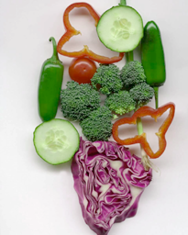
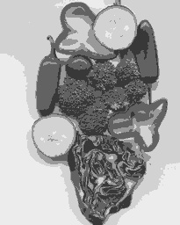

Results of K-Means Clustering:
Image
Clusters on intensity
Clusters on color
K-means clustering using intensity alone and color alone
* From Marc Pollefeys COMP 256 2003
Notes:
I gave each pixel the mean intensity or mean color of its cluster --- this is basically just vector quantizing the image intensities/colors. Notice that there is no requirement that clusters be spatially localized and they’re not.

Slide 55
Optional Section:
Fitting with RANSAC
(RANdom SAmple Consensus)
Who should read?
Everyone doing a project that requires:
  Structure from motion or
  finding a Fundamental or Essential matrix

Slide 56
RANSAC
Choose a small subset uniformly at random
Fit to that
Anything that is close to result is signal; all others are noise
Refit
Do this many times and choose the best
Issues
  How many times?
    Often enough that we are likely to have a good line
  How big a subset?
    Smallest possible
  What does close mean?
    Depends on the problem
  What is a good line?
    One where the number of nearby points is so big it is unlikely to be all outliers
* From Marc Pollefeys COMP 256 2003
Notes:
This algorithm contains concepts that are hugely useful; in my experience, everyone with some
experience of applied problems who doesn’t yet know RANSAC is almost immediately able to use it to simplify some problem they’ve seen.

Slide 57

* From Marc Pollefeys COMP 256 2003

Slide 58


Distance threshold
Choose t so probability for inlier is α (e.g. 0.95)
Often empirically
Zero-mean Gaussian noise σ then follows
distribution with m=codimension of model
(dimension+codimension=dimension space)
Codimension | Model | t ²
1 | line,F | 3.84σ²
2 | H,P | 5.99σ²
3 | T | 7.81σ²
* From Marc Pollefeys COMP 256 2003

Slide 59


How many samples?
Choose N so that, with probability p, at least one random sample is free from outliers. e.g. p=0.99
 | proportion of outliers e
s | 5% | 10% | 20% | 25% | 30% | 40% | 50%
2 | 2 | 3 | 5 | 6 | 7 | 11 | 17
3 | 3 | 4 | 7 | 9 | 11 | 19 | 35
4 | 3 | 5 | 9 | 13 | 17 | 34 | 72
5 | 4 | 6 | 12 | 17 | 26 | 57 | 146
6 | 4 | 7 | 16 | 24 | 37 | 97 | 293
7 | 4 | 8 | 20 | 33 | 54 | 163 | 588
8 | 5 | 9 | 26 | 44 | 78 | 272 | 1177
* From Marc Pollefeys COMP 256 2003

Slide 60

Acceptable consensus set?
Typically, terminate when inlier ratio reaches expected ratio of inliers
* From Marc Pollefeys COMP 256 2003

Slide 61

Adaptively determining the number of samples
e is often unknown a priori, so pick worst case, e.g. 50%, and adapt if more inliers are found, e.g. 80% would yield e=0.2
  N=∞, sample_count =0
  While N >sample_count repeat
    Choose a sample and count the number of inliers
    Set e=1-(number of inliers)/(total number of points)
    Recompute N from e
    Increment the sample_count by 1
  Terminate
* From Marc Pollefeys COMP 256 2003

Slide 62


RANSAC for Fundamental Matrix
Step 1. Extract features
Step 2. Compute a set of potential matches
Step 3. do
  Step 3.1 select minimal sample (i.e. 7 matches)
  Step 3.2 compute solution(s) for F
  Step 3.3 determine inliers
until Γ(#inliers,#samples)<95%
(generate
hypothesis)
(verify hypothesis)
Step 4. Compute F based on all inliers
Step 5. Look for additional matches
Step 6. Refine F based on all correct matches
#inliers | 90% | 80% | 70% | 60% | 50%
#samples | 5 | 13 | 35 | 106 | 382
* From Marc Pollefeys COMP 256 2003

Slide 63
Randomized RANSAC for Fundamental Matrix
Step 1. Extract features
Step 2. Compute a set of potential matches
Step 3. do
  Step 3.1 select minimal sample (i.e. 7 matches)
  Step 3.2 compute solution(s) for F
  Step 3.3 Randomize verification
  3.3.1 verify if inlier
  while hypothesis is still promising
while Γ(#inliers,#samples)<95%
(generate
hypothesis)
(verify hypothesis)
Step 4. Compute F based on all inliers
Step 5. Look for additional matches
Step 6. Refine F based on all correct matches
* From Marc Pollefeys COMP 256 2003

Slide 64






Example: robust computation
from H&Z
Interest points
(500/image)
(640x480)
#in | 1-e | adapt. N
6 | 2% | 20M
10 | 3% | 2.5M
44 | 16% | 6,922
58 | 21% | 2,291
73 | 26% | 911
151 | 56% | 43
Putative correspondences (268)
(Best match,SSD<20,±320)
Outliers (117)
(t=1.25 pixel; 43 iterations)
Inliers (151)
Final inliers (262)
(2 MLE-inlier cycles;
d⊥=0.23→d⊥=0.19;
Iter_{Lev-Mar}=10)
* From Marc Pollefeys COMP 256 2003

Slide 65
More on robust estimation
LMedS, an alternative to RANSAC
(minimize Median residual in stead of
maximizing inlier count)
Enhancements to RANSAC
  Randomized RANSAC
  Sample ‘good’ matches more frequently
  …
RANSAC is also somewhat robust to bugs, sometimes it just takes a bit longer…
* From Marc Pollefeys COMP 256 2003

